Slide 1
Annual Program Review
MMC Dept of Surgery

Slide 2
Agenda
Resident Performance
  ABSITES
  Academic Productivity
  Cases
Graduate Performance
  QE/CE
  Graduate Survey
Faculty Performance
  Academic Productivity
  Rotation Evaluations
Program Performance
  Survey
  Match/Recruitment
Surgical Education Fund- update
Review of Last year’s projects
  Microaggressions
  Mentorship
  SLC Redesign
  Evaluations
  Citation Clearance
  Interview Process
This years projects
  Wellness
  F/U
  Chat Bomb

Slide 3
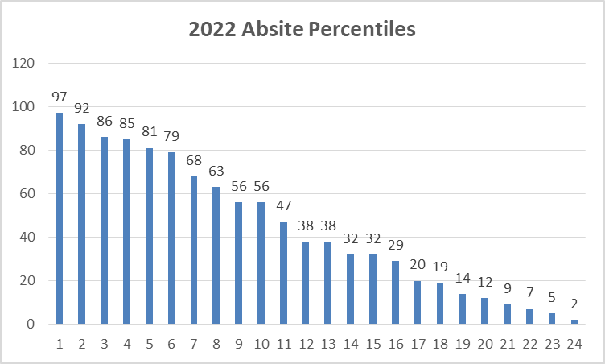

Slide 4
Resident Performance, Academic Productivity

Slide 6
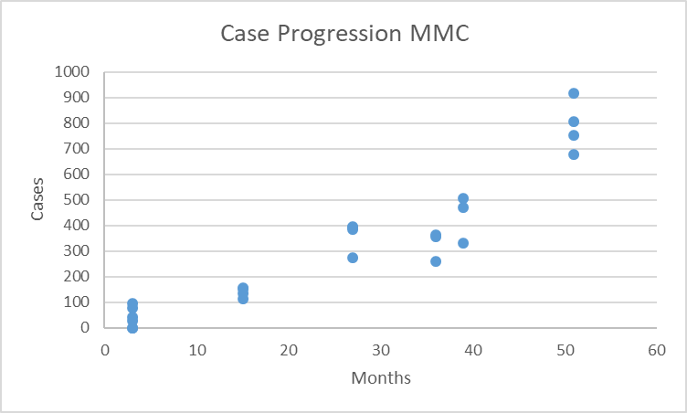
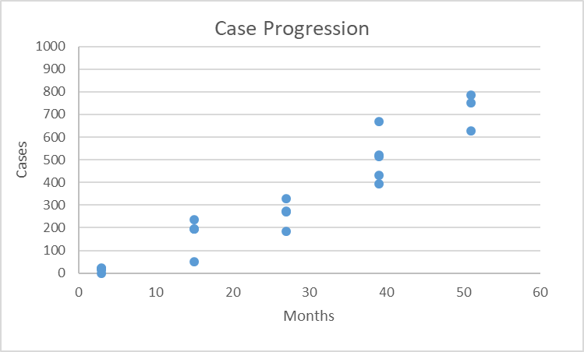
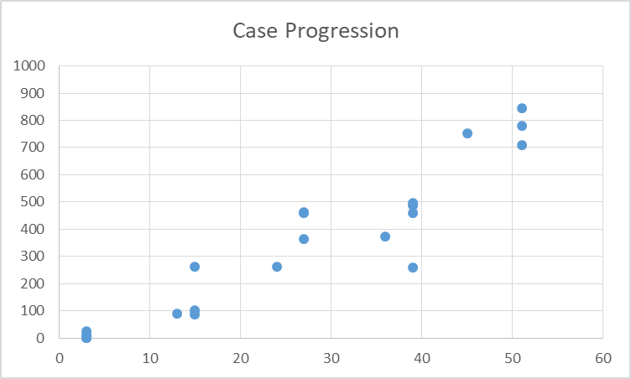
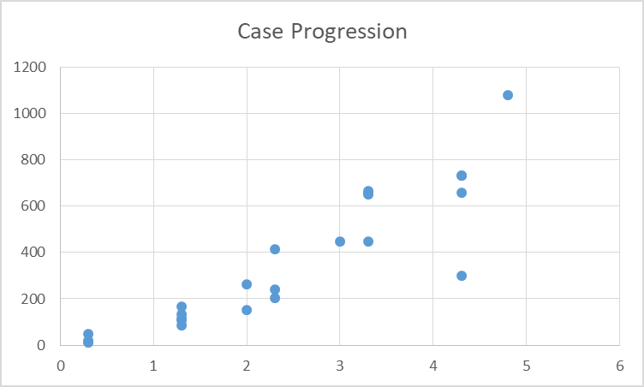
2019
2020
2021
2022

Slide 7
Why the discrepancies?
Rotation Differences have been minimal over 15 months, A has done Breast vs Night Float for B. B did a month of ACS where A did Trauma
A leads B in every category

Slide 8
First Assists Comparison to National
Percentile | Number of Cases
10th | 3
30th | 15
50th | 30
70th | 51
90th | 108
MMC Average

Slide 9
Board Pass Rates

Slide 10
This years QE
Meader, Pletch, Zhang, Heidt, Gleaton, MacDowell all passed (easily).

Slide 11
Graduate Survey
(Not a survey year)
https://www.surveymonkey.com/stories/SM-68H9T2YY/

Slide 12
Faculty Performance
Personal and Rotation Evaluations
  To be distributed to individuals as well as Division Directors
  Academic contributions as collected by Freddie and Administrative Contributions will be incorporated
  Final review supplied for MMP Annual Review Process

Slide 13
Faculty Performance-Scholarly Activity
Notes:
12 faculty with pub med ids, a dou
Bling over the last 5 years in the number of attendings as well, this year 15 this year

Slide 14
Resident Survey

Slide 15
Faculty Survey

Slide 16
Match

Slide 17
Holistic Review
Currently working to separate interviews from portfolio review
Continuing with behavioral interviewing with some edits
Make personal statements available

Slide 18
Surgical Education Fund
Integrated into the MMC Capital Campaign-Donations are tax deductible
Rules for Governance developed by Foundation Committee
“MMC Condo” Donation was rolled into fund
Fund total stands at TBD

Slide 19
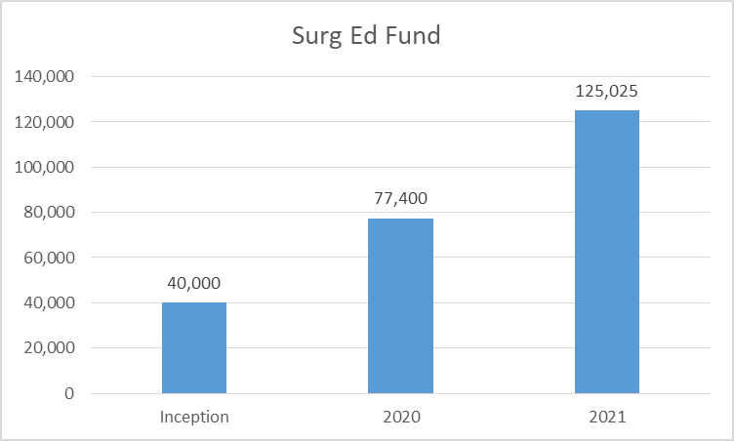

Slide 20
Second Trial

Slide 22
SLC Redesign
Idea booted around at Summer 2020 Retreat
Plans worked out in Fall of 2020 and inquiries made
  No, we aren’t allowed to do the work ourself
MMC “space force” brought in Winter 2020-21
  Initial estimate ~$30,000
  Back to “space force”, adjustments made, estimate down to ~$22,000
Request made to capital expenditures spring 2021
Turned down
Went back to get new estimate
DME will chip in, ? Should function be the same

Slide 23
Summer Retreat
My TIPS
Autonomy

Slide 24
This year’s projects
My TIPS
Didactic Redesign
Education 1 in 7
Patient Evaluation
Autonomy
SLC redesign
Continue Holistic Review

Slide 25
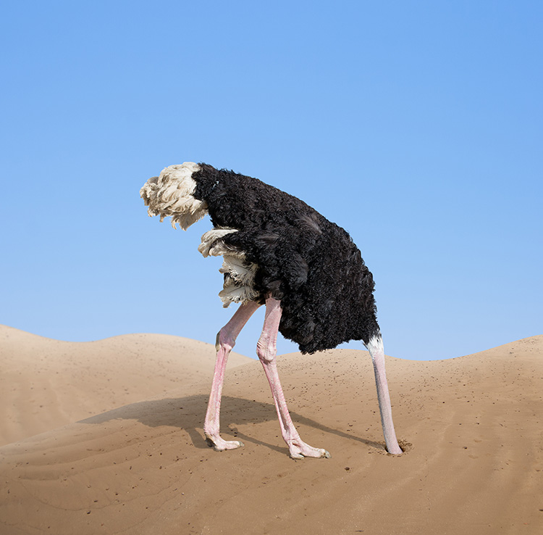
How come there isn’t anything about professionalism, gender bias, etc?

Slide 26
My tips

Slide 27
Conference engagement
Attendance at both Mnm and Grand Rounds has been poor
  We are still not where we can put everyone in Dana 7
  Even when attending on zoom the black screen and multitasking detracts.
  The lack of block time has put increased pressures to miss conference
  The new CME system has meant we haven’t been able to get CME for mnm
There is an ACGME requirement to attend 75% of core conferences
How do we address given the limitations?

