Slide 2
Needles, Sutures, instruments

Slide 3
Needles
Cutting
Useful for sutures that need to pass through dense tissue
Conventional
Risk of cutting through wound
uncommon

Slide 4
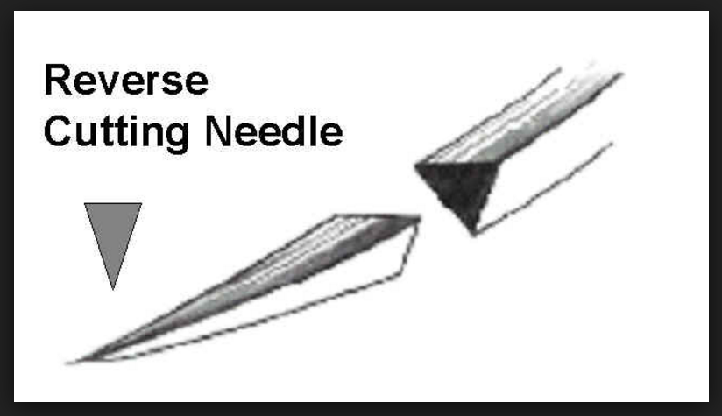
Needles
Cutting
Useful for sutures that need to pass through dense tissue
Reverse
Theoretically cuts outward

Slide 5
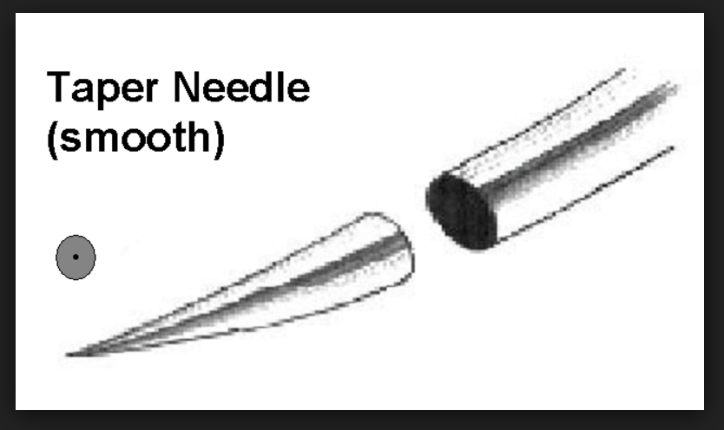
Needles
Needle points
Taper

Slide 6
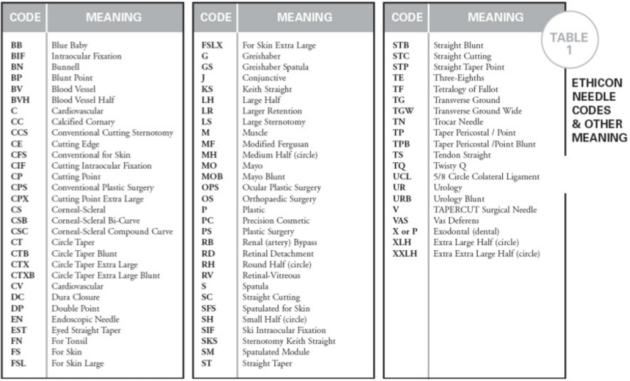

Slide 9
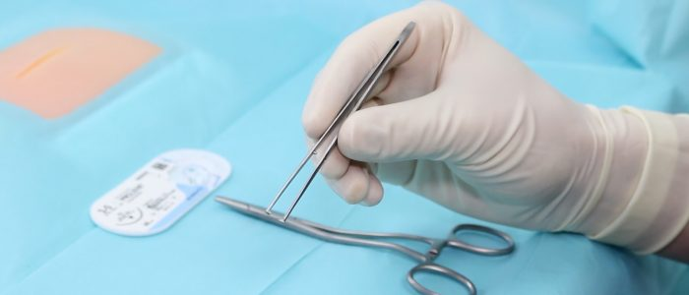

Slide 10
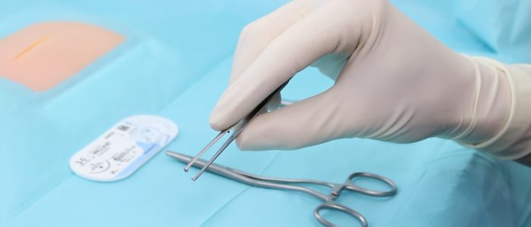
NO

Slide 11
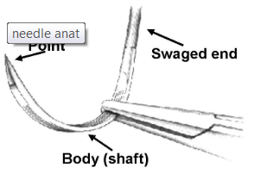
Suturing

Slide 12
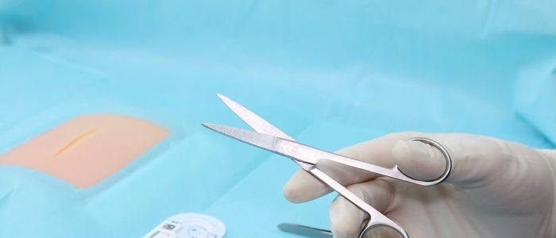

Slide 13
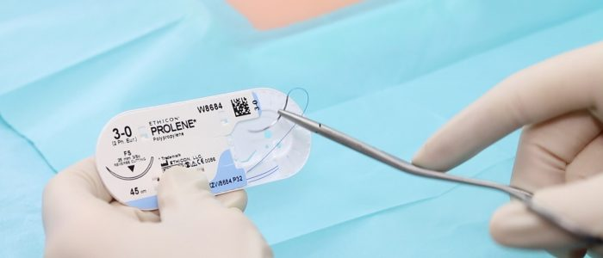
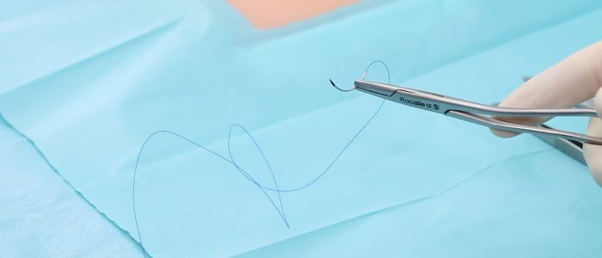

Slide 14
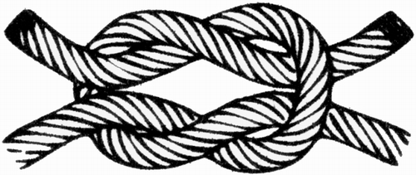
Knots

Slide 15
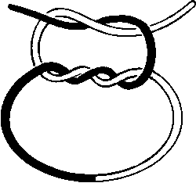

Slide 16
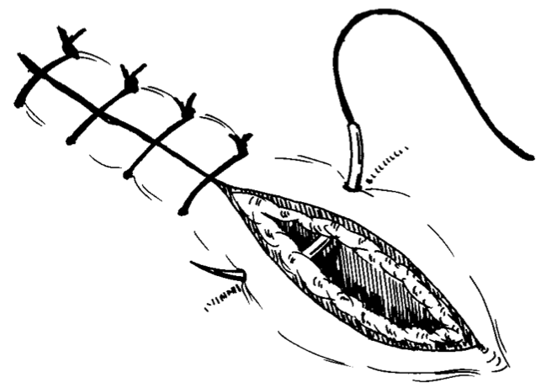

Slide 17
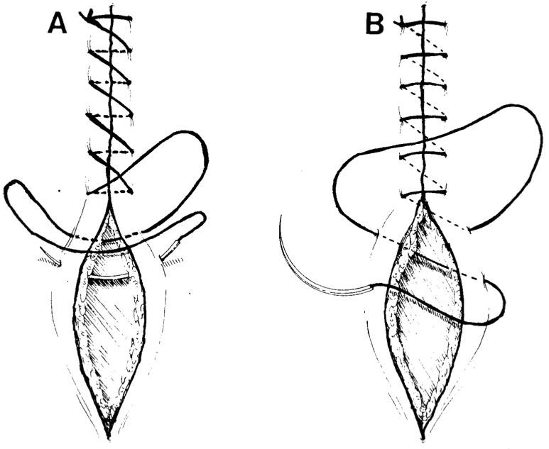

Slide 18
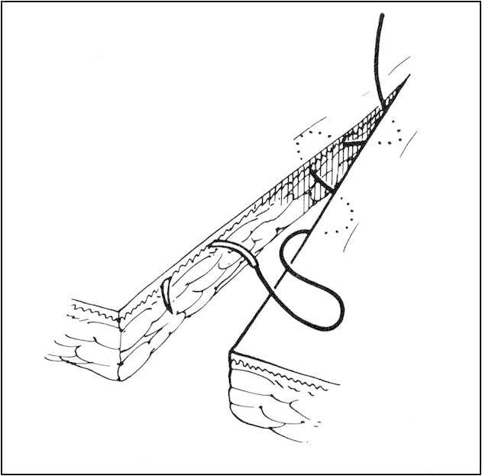

Slide 19
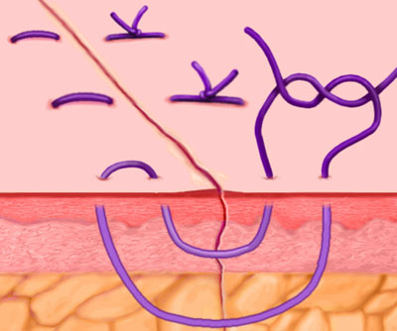

Slide 20
